Slide 1
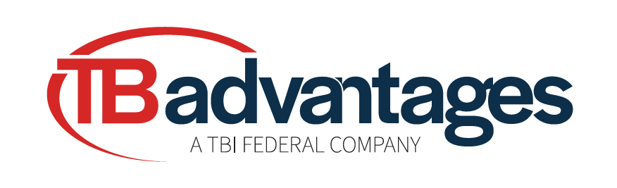
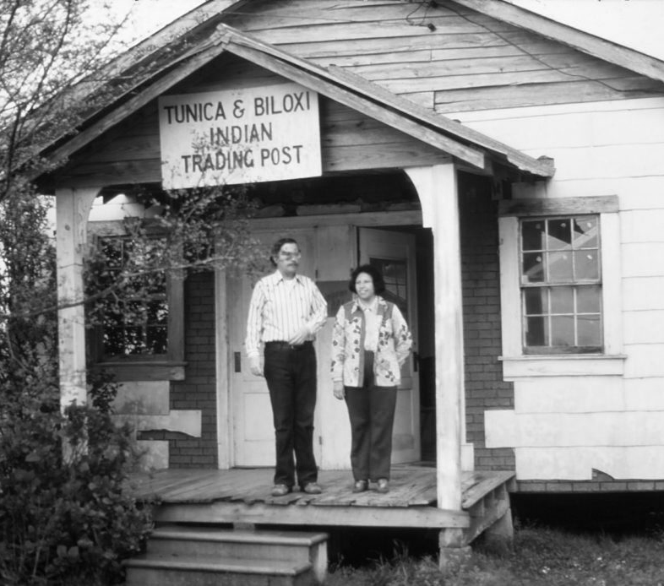
ABOUT US
Tunica-Biloxi Advantages, LLC (TBA) was formed as a wholly owned subsidiary of the Tunica-Biloxi Tribe of Louisiana to provide high-impact administrative and general management services to federal organizations. Our mission is to provide tailored, results-driven solutions that address the evolving needs of government organizations across strategy, budget, technology, and operations challenges. We help agencies to improve performance, enhance efficiency, and achieve mission success.
As a portfolio company of TBI Federal, we bring the acquisition advantages of a small business with the execution rigor of seasoned federal leaders. This arrangement offers access to streamlined contracting pathways while providing high-quality, accountable service delivery.
Our deep understanding of the federal landscape coupled with strong subject matter expertise allows us to bring a unique perspective to our partnerships as we help agencies to navigate challenges, mitigate risk, and implement sustainable change. At TBA, we are committed to delivering measurable impact and supporting our clients with the agility and strategic perspective needed to succeed in today’s dynamic federal environment.
We help federal organizations focus on mission priorities through clear strategy, efficient operations, and practical solutions that reduce administrative burden.
CAPABILITIES
BUSINESS MANAGEMENT
Strategic business management solutions that improve performance and streamline operations. TBA simplifies business management with data-driven insights, deep federal expertise, and sustainable processes.
BUSINESS MANAGEMENT SERVICES INCLUDE:
Program Management Office (PMO)
Staff Augmentation
Call Center Support
Training Development and Delivery
Management Consulting
Reorganizational Support
Quality Assurance and Compliance Monitoring
Market Analysis and Business Planning
Business Process Improvement and Impact Analysis
Strategic Communications
Branding and Campaign Management
TUNICA-BILOXI ADVANTAGES
CORPORATE OVERVIEW
tbifederal.com

Slide 2
ADMINISTRATIVE MANAGEMENT
Seamless day-to-day operations require organization and efficiency behind the scenes. We enhance productivity through streamlined processes, detailed coordination, and proactive oversight tailored to your mission needs.
ADMINISTRATIVE MANAGEMENT SERVICES INCLUDE:
Office Management and Staffing Services
Clerical and Secretarial Support
Records Management
Scheduling and Resource Coordination
Administrative Oversight and Operational Advisory Support
Customer Experience
Strategic Capital Planning and Budgeting
IT SERVICES
Our trusted technical advisors ensure the operational efficiency and infrastructure resiliency needed to align your organization’s technology and mission priorities.
IT SERVICES INCLUDE:
Enterprise IT
Software Management
Systems Engineering and Integration
Cybersecurity
Help Desk Services
DATA ANALYTICS SERVICES
Informed decision-making starts with clear, actionable insights derived from data. Through advanced analytics, visualization, and forecasting, we help agencies to uncover trends, optimize operations, and plan with confidence.
DATA ANALYTICS SERVICES INCLUDE:
Data Clean Up and Data Management
Data Visualization, Dashboards, and Reporting
Workload and Workforce Analysis
Customer Insight and Customer Experience Survey Administration and Analysis
Forecasting and Predictive Analytics
Inventory Tracking
TUNICA-BILOXI ADVANTAGES
CORPORATE OVERVIEW
tbifederal.com

Slide 3
ACQUISITION MANAGEMENT
TBA helps agencies to navigate the acquisition process with efficiency, compliance, and confidence. Our streamlined processes reduce risk and ensure successful contracting outcomes.
ACQUSITION MANAGEMENT SERVICES INCLUDE:
Market Research
Acquisition Planning
Procurement Management
Solicitation Support
Negotiation and Award Support
Post Contract Administrative Support
BUDGET PLANNING & FINANCIAL MANAGEMENT
TBA helps agencies to navigate the acquisition process with efficiency, compliance, and confidence. Our streamlined processes reduce risk and ensure successful contracting outcomes.
BUDGET MANAGEMENT SERVICES INCLUDE:
Budget Reporting and Analysis
Risk Management
Strategic Budget Planning
Financial Forecasting and Analysis
CONTRACT WITH US
SAM Unique Entity ID
QVKUQMVEFLH4
CAGE Code: 117A8
NAICS Code: 541611
Expedited Procurement
Reduced contracting risk
Shared Infrastructure with TBI Federal
Clyde Thompson
Chief Executive Officer TBI Federal
clyde.thompson@tbifederal.com
478.304.3080
POINTS OF CONTACT
HEADQUARTERS
Tunica-Biloxi Reservation Marksville, Louisiana
FIELD OFFICES
Dublin, GA
Arlington, VA Atlanta, GA
info@tbifederal.com
tbifederal.com
TUNICA-BILOXI ADVANTAGES
CORPORATE OVERVIEW

